Slide 1
Team 3: XOXO Gossip Girl
Anezka Potesilova, Eleni Liarou
Charlotte Koolen, Yuxin Dong
31/01/2025

Slide 2
Who likes to gossip?

Slide 3
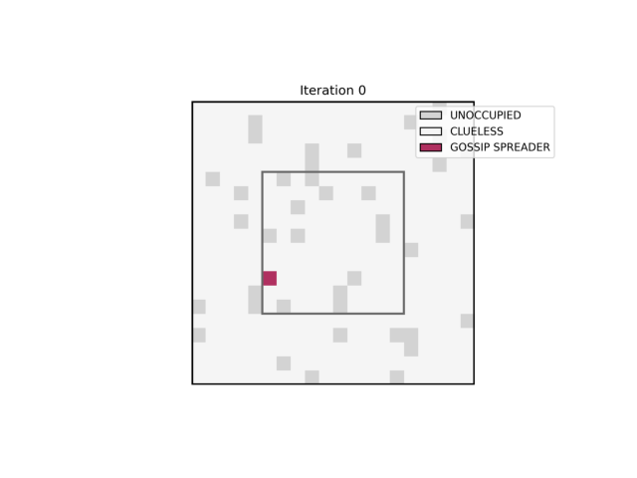
Notes:
Starts with 1 gossip spreader and spreads in the whole lecture hall (so there is percolation)

Slide 4
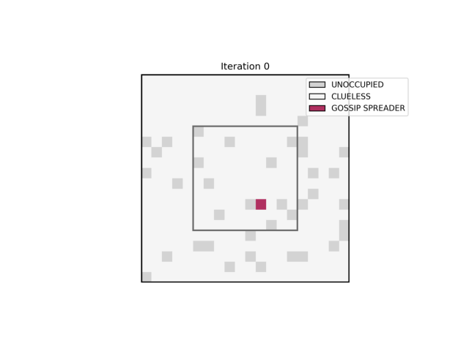
Notes:
No percolation since the spreading stops

Slide 5
Outline
Introduction
Terminology
Research Questions
Hypotheses
Model
Results and Analysis
Conclusion
Q&A
References
Notes:
Introduction
Terminology
– Charlotte
—————————
Research Questions
Hypotheses
Model
– Yuxin
—————————
Results and Analysis
Conclusion
References
Q&A
— Elena & Anezka

Slide 6
Introduction

Slide 7
Introduction
What is rumour
propagation and why is it
important?
Where do we see rumour dynamics in real life?
What complex phenomena emerge in rumour spreading?
Critical phenomenon in social dynamics
Confined environments
Gu & Ding (2013): density and individual spreading intention
Public communication
Misinformation control
Social influence modeling
Percolation under different parameters
Social sciences
Complex Systems Theory
Notes:
1. What is rumour propagation, and why is it important?
Spread of information (a rumour) through a network of individuals
Critical phenomenon in social dynamics
In confined environments (physical limitations that restrict movement -> lecture hall), structure of space constraints how a rumour can spreads
Gu & Ding (2013) Researchers investigated how density and individual spreading intention affect rumour propagation
2. Where do we see rumour dynamics in real life?
Public communication, misinformation control, and social influence modeling
3. What complex phenomena emerge in rumour spreading?
Percolation under different parameters
Contributing to both social sciences and complex systems theory

Slide 8
Terminology

Slide 9
Bond probability
Terminology
Percolation
Density
Critical Point
Initial spreader position
Moore Neighbourhood
Von Neumann Neighbourhood
Notes:
Percolation: cluster (of gossip spreaders) in 2D grid reaches from one side to the opposite side. Since it is a grid with equally long sides: this can be horizontally or vertically (no need for both, because it is symmetrical)
Critical Point: point after which percolation starts to occur
Density: how many students
Bond probability: bonds parameter if a connection between two students is present or not (so if a bond is present, the rumour can spread from one student to the other if the rumour arrives at one of the students)
Von Neumann Neighbourhood: 4 neighbours, only horizontal and vertical neighbours
Moore Neighbourhood: 8 neighbours, also diagonal
Initial spreader position: 1 spreader in center or edge

Slide 10
Research Questions

Slide 11
Research Questions
How does the rumour percolation probability change as the density of student changes?
How does the rumour percolation probability change as the bond probability of student changes?
How do the critical points vary when the neighbourhood structure is altered?
How does the location of the initial rumour source affect its propagation?
How do the critical points change if we consider both site and bond percolation?
Notes:
First two questions are about how the percolation probability changes as the density or the bond probability of students or both them change
For there are 2 neighborhoods to use ,wo want to know if the structure alters, what will happen to the critical point
And the fourth question, the rumor can start in the center of the classroom or in the corner, how will the propagation be affected by the initial rumor source position
The last one, we have site and bond percolation, if we combine the two conditions that both of them should be considered to be percolation, how will the critical points change.

Slide 12
Hypotheses

Slide 13
Hypotheses
There is a point for density after which percolation probability increases rapidly
There is a point for bond probability after which percolation is inevitable
The Moore neighborhood is expected to have lower critical points
A rumour originating from the center of the lecture hall has a higher probability of leading to percolation compared to a rumour starting at the edge
As density decreases a higher bond probability is required for percolation to occur and vice versa
Notes:
For the first one ,when density reaches one point, we expect a rapid increase in percolation probability .
And then the second, we assume that when bond probability proceeds one point, we can have inevitable percolation.
The third one, we expect to see lower critical points when using Moore neighborhood, as the connections are more.
And for the fourth one, we assume that the rumor pops up in the center has a higher probability of leading to percolation than the edge.
The last hypothesis is, when density drops, then the bp has to be high for making the rumor continue spreading

Slide 14
Model

Slide 15
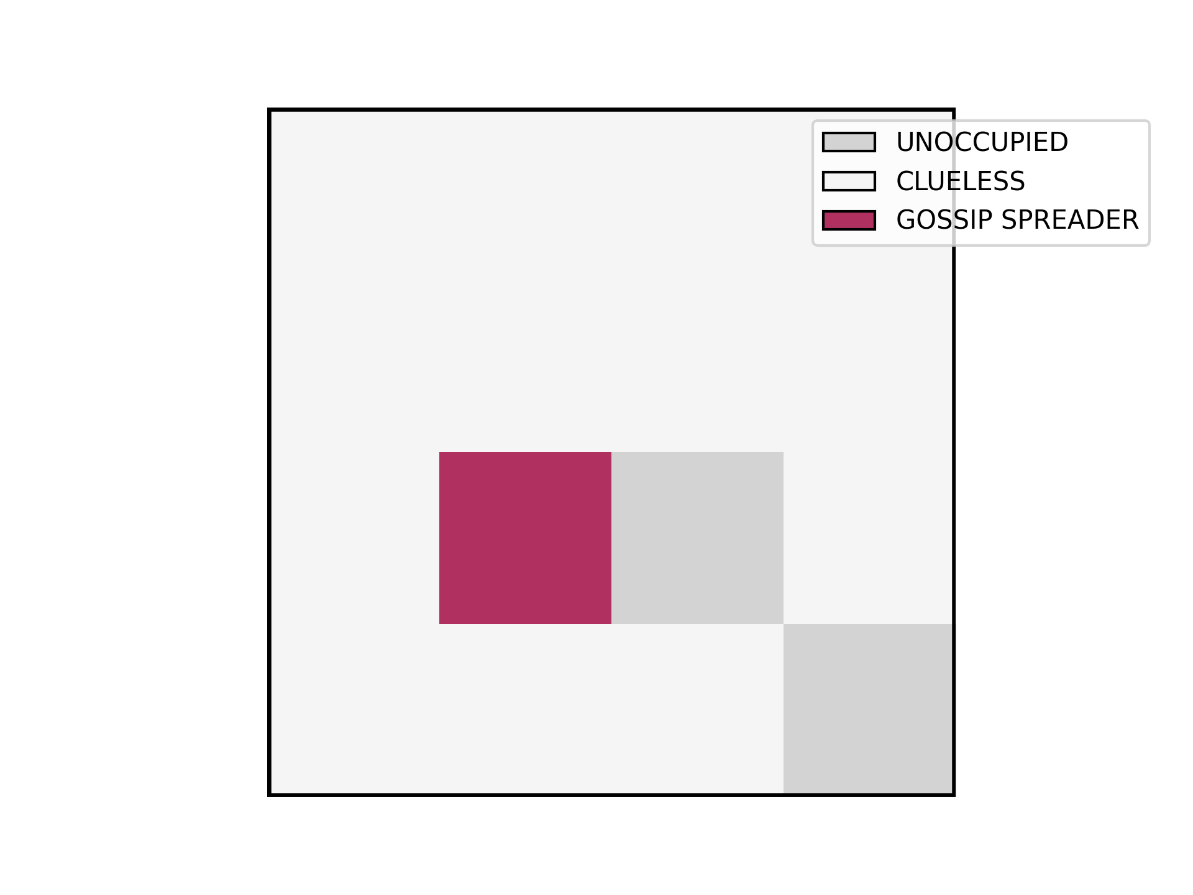
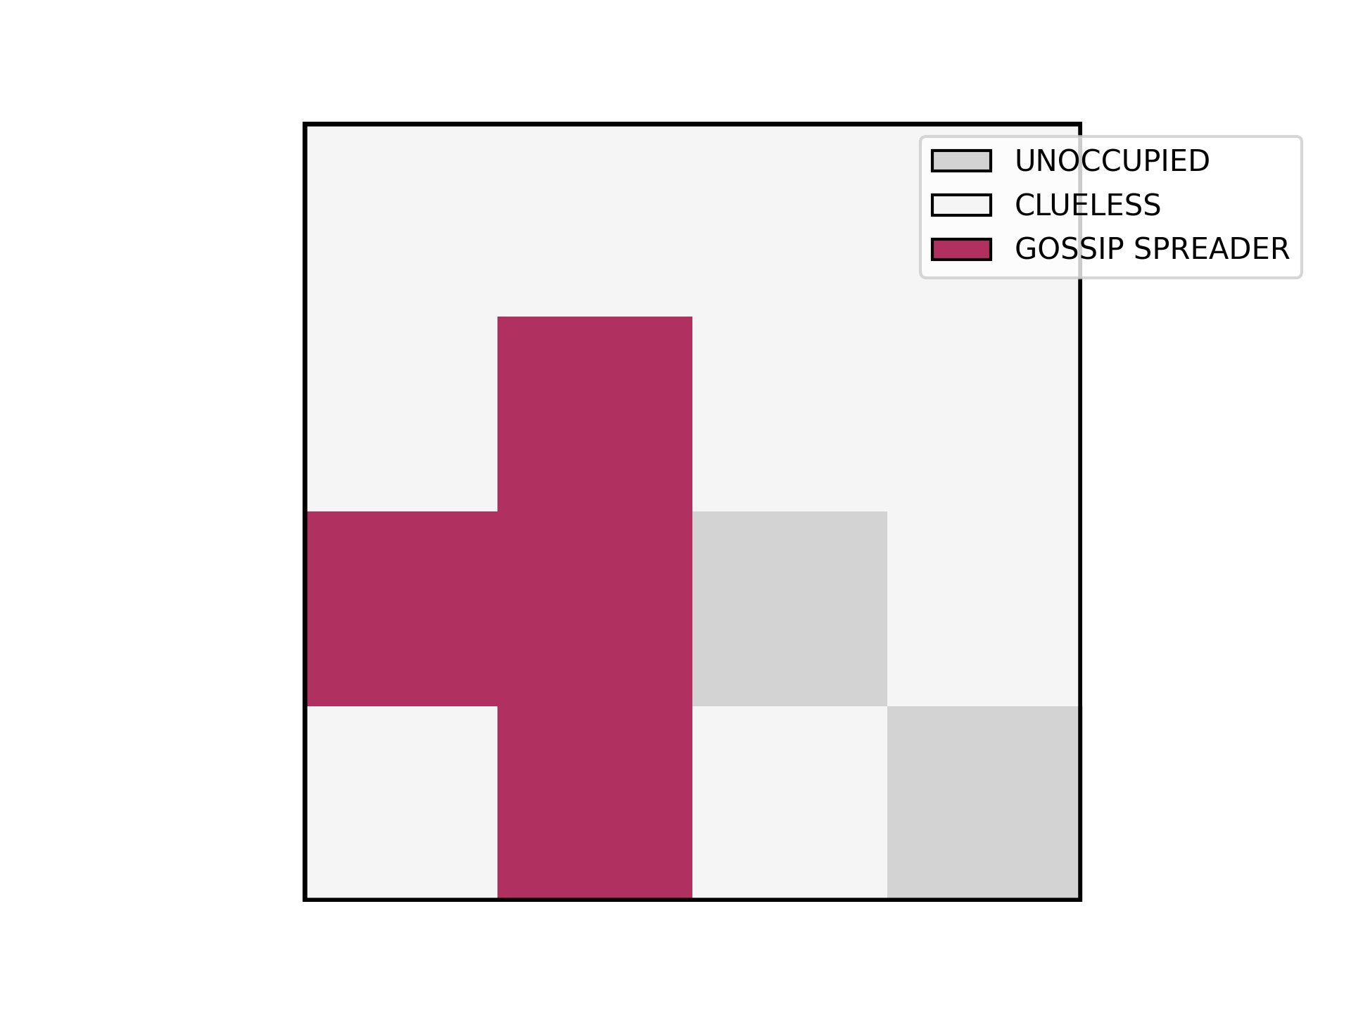
Model
Based on Gu & Ding 2013
Stochastic 2D CA
Grid Size: 20x20
Moore or Von Neumann neighbourhood
Blocking boundary condition
Default #simulations: 300
Near the critical points #simulations: 600
States
Unoccupied
Clueless
Gossip Spreader
Notes:
We set up a stochastic 2D cellular automata model with size of 400 cells / 2 neighborhoods / enclosed classroom
We default 300 simulations to run, which is enough for this size, but we still applied 600 in some cases to get closer to the critical points
Here we split the states into 3 types: the unoccupied, the clueless, and the gossip spreader.
In the grid, each cell has its own state.
The density defines the proportion of the unoccupied and the initial clueless, both of them placed randomly.
And when a rumor occurs, we have to check its neighbors’ states if there is any cell clueless
And then we check the bond between, if it’s open, the clueless becomes gossiper too, if closed, the clueless stays the same, the spreading stops.
The two plots above, in one iteration from the beginning, the gossip spreader spreads rumor to the three neighbors.
And once the model is done, we run the simulations, and then do the visualizations.

Slide 16
Results and Analysis

Slide 17
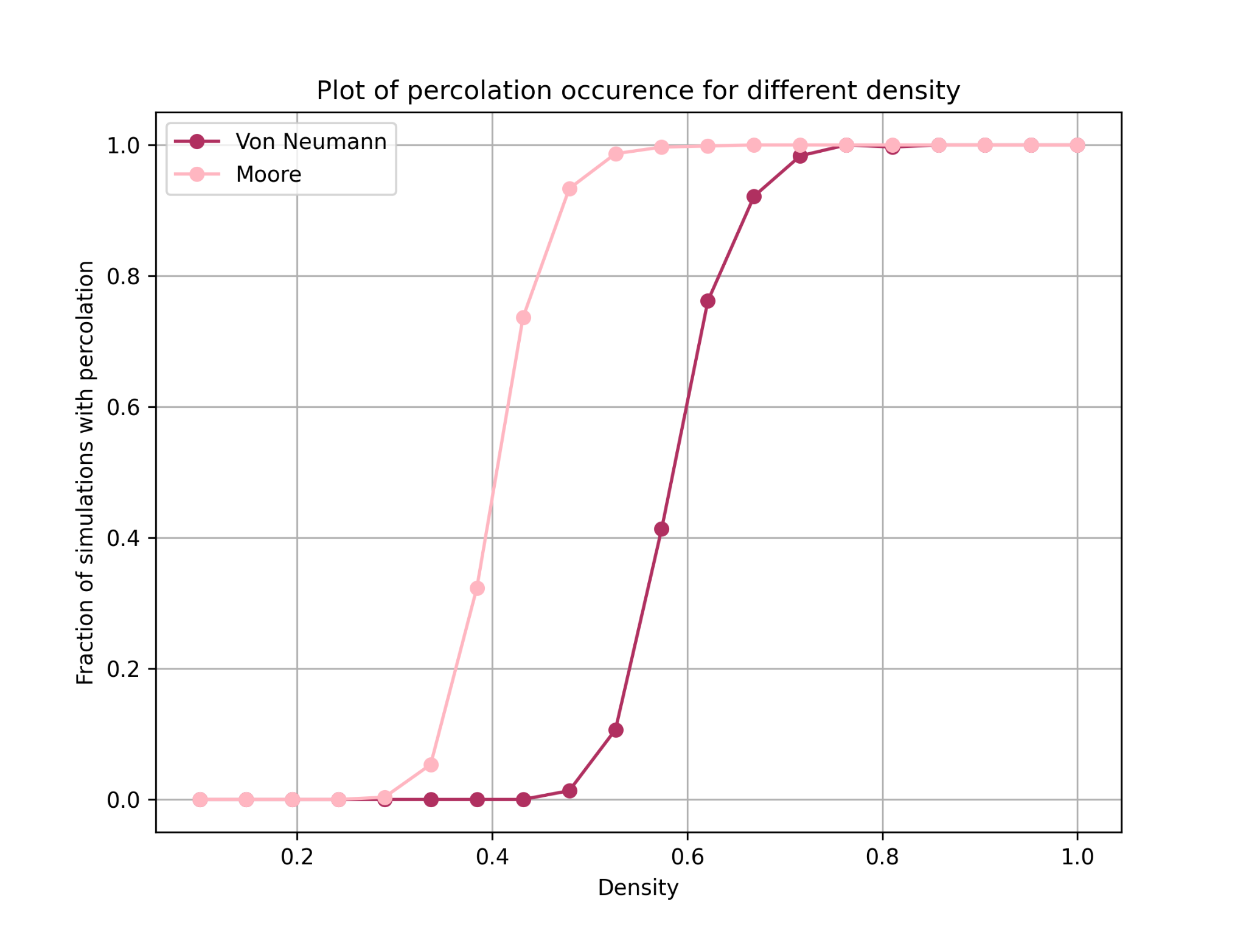
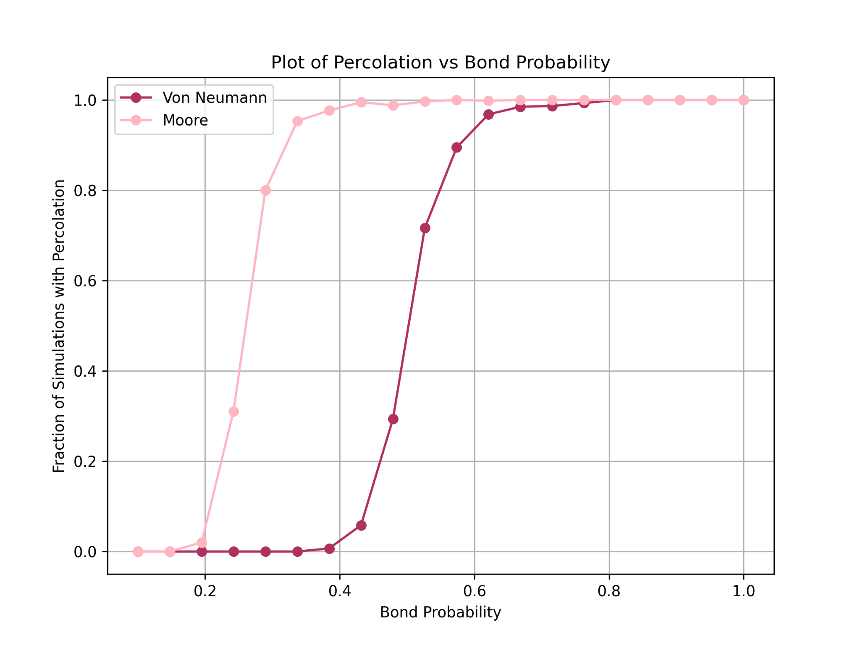
Initial Spreader in the Center
Site percolation
Bond percolation
Notes:
Mention that the expected critical point for Von Neumann is
site percolation: 0.59
bond percolation: 0.5
The expected critical point for Moore is
site percolation: 0.41
bond percolation: 0.25 - 0.30
more connections lead to faster percolation
critical point is not strict because we have a finite lattice
for bond percolation the transition is a but longer than site percolation

Slide 18
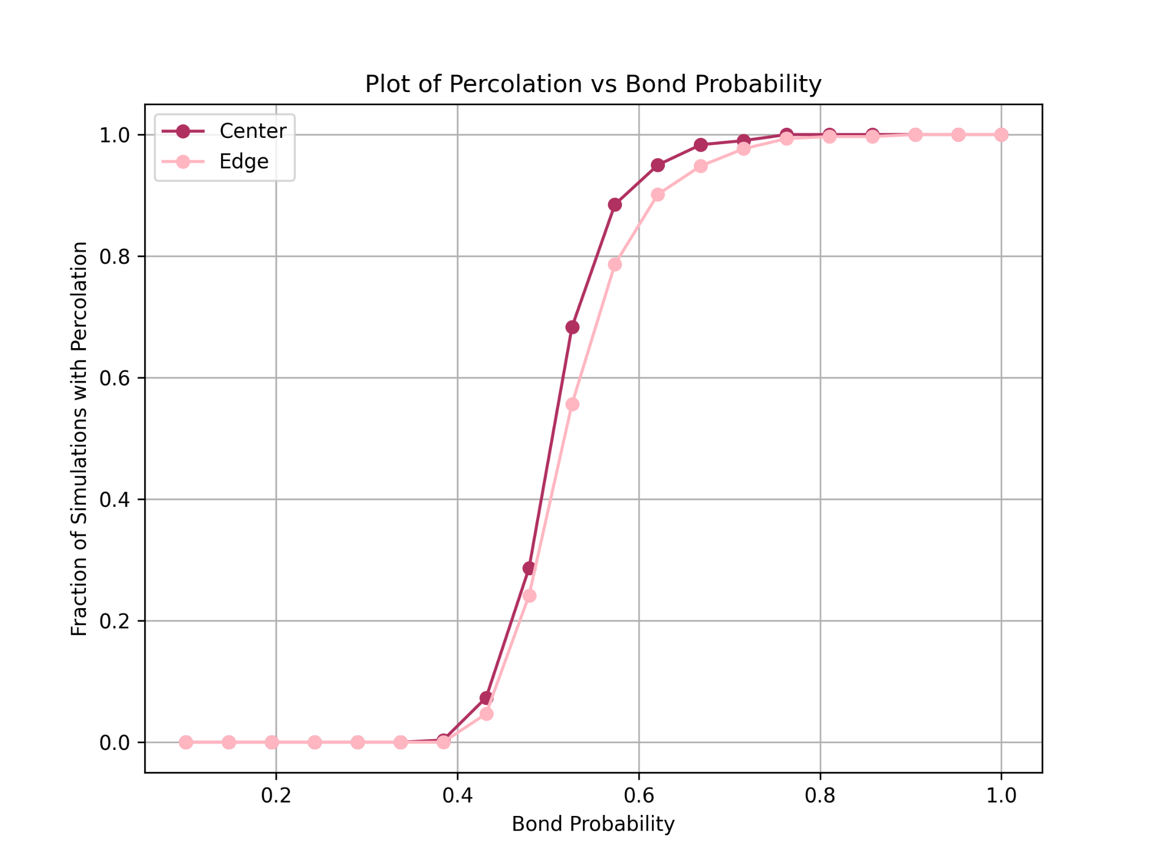
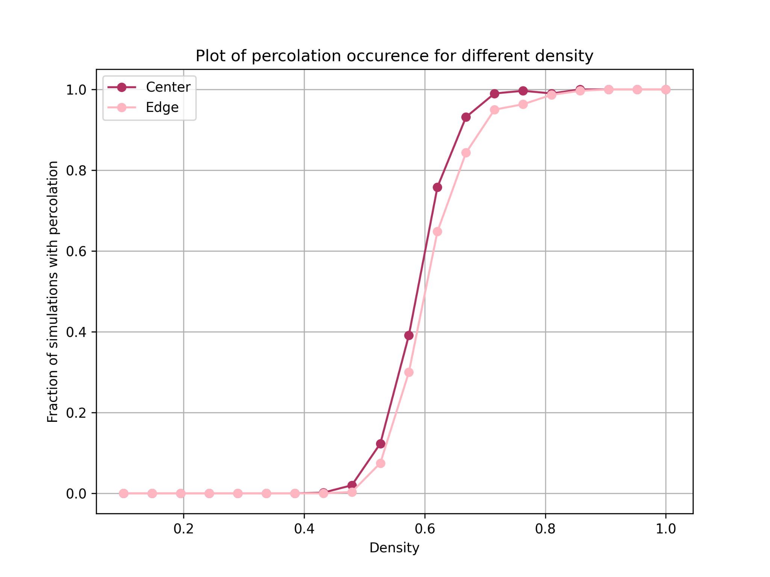
Von Neumann Neighbourhood
Initial Spreader in the Edge
Site percolation
Bond percolation
Notes:
Question: How does the initial spreader position affect percolation
Hypotheses:Is it more easier to percolate than the center one？
once the system is large enough, moving the initial spreader only affects the local dynamics
the percolation transition depends on the global connectivity of the occupied sites and active bonds, rather than the initial location
as long as the system is above the percolation threshold, the rumour will always find a percolating path regardless of where it starts
we measured time, but again we did not observe any significant change

Slide 19
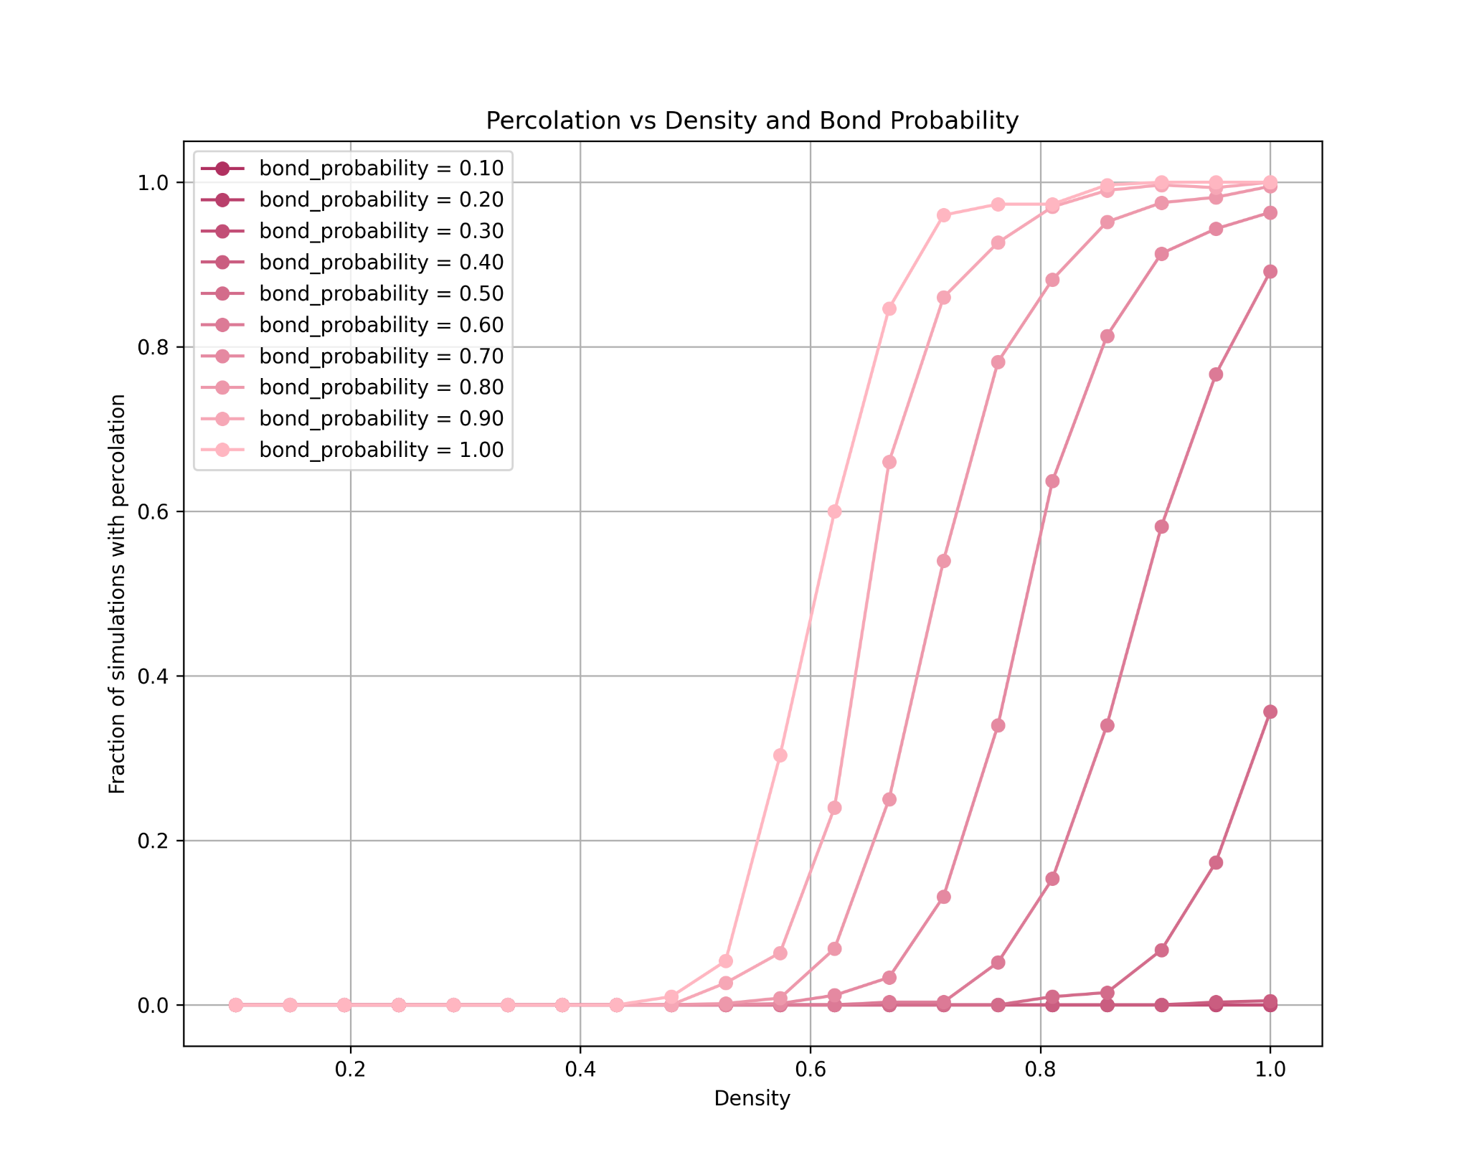
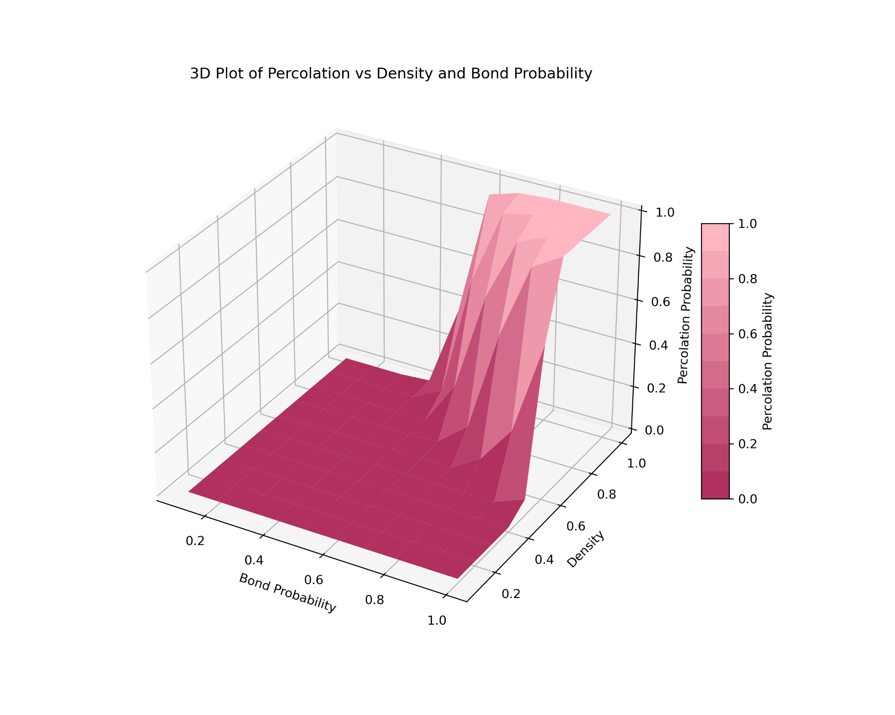
Von Neumann Neighbourhood
Site-Bond Percolation
Notes:
only if both density (0.8-1) and bond probability (0.8-0.9) can percolation be guaranteed 100% of the time

Slide 20
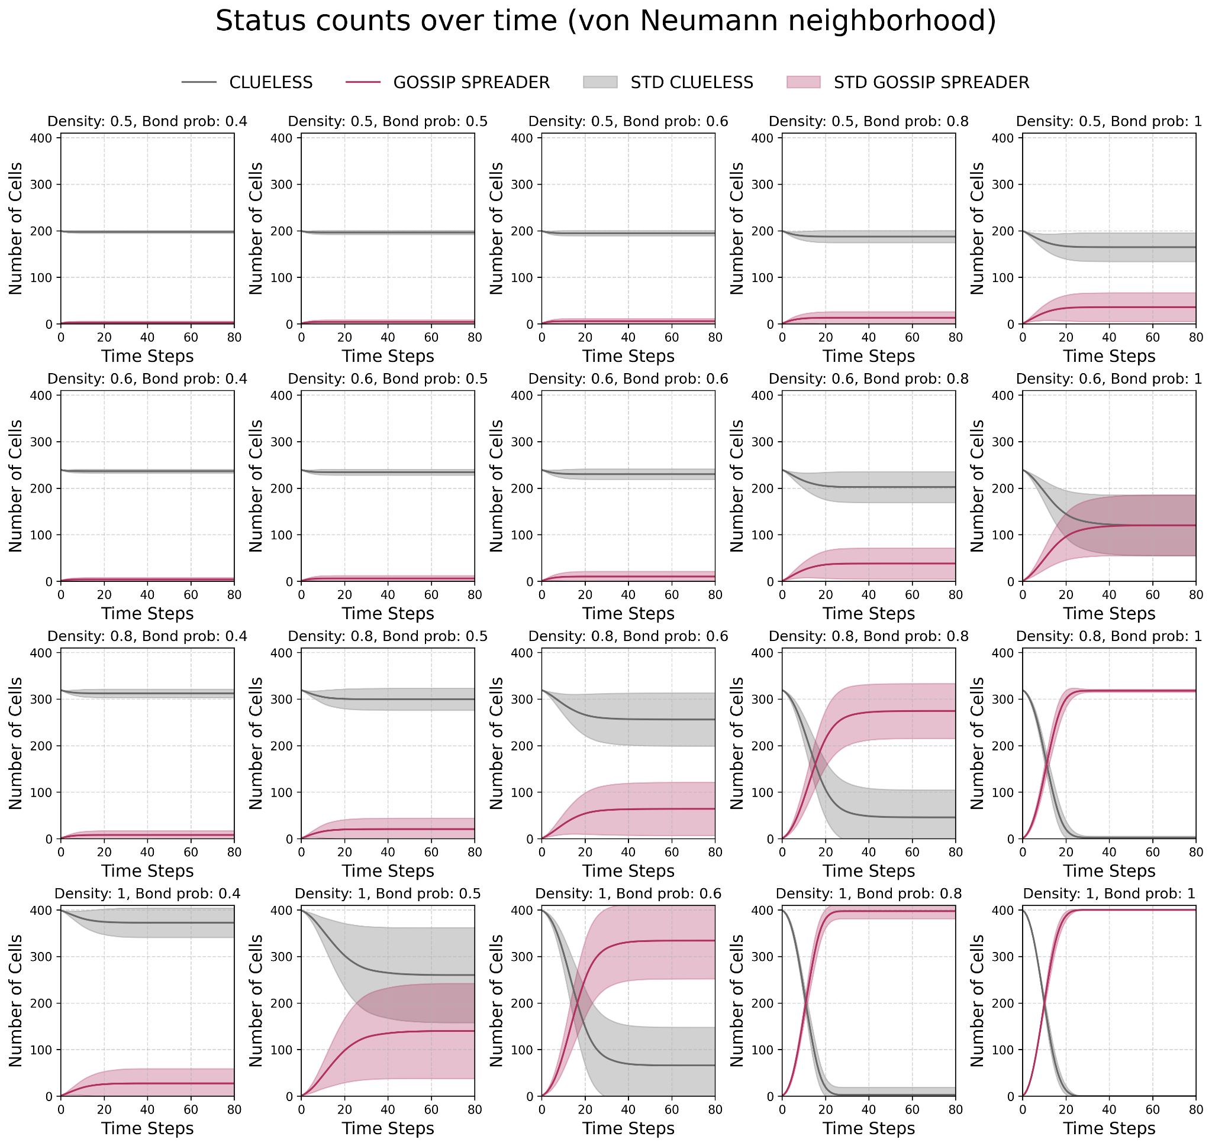
Notes:
How the gossip spreads over time
For different densities and probabilities
Together with the standard deviation
Around critical point, the std is the largest
On the right, we can see that the bond probability has a smaller area about the critical point with std, it picks up more rapidly than bond percolation
We can also interpret this as the size of the biggest/only/percolation cluster and the probability that a site is in the percolation cluster
Before the critical point, there is simply no percolation cluster, for values after the critical point, there is just one huge cluster spanning almost the whole screen
what does the rapid change between plots mean - relate to the parameters and critical point vN:
d - 0.59
p - 0.5

Slide 21
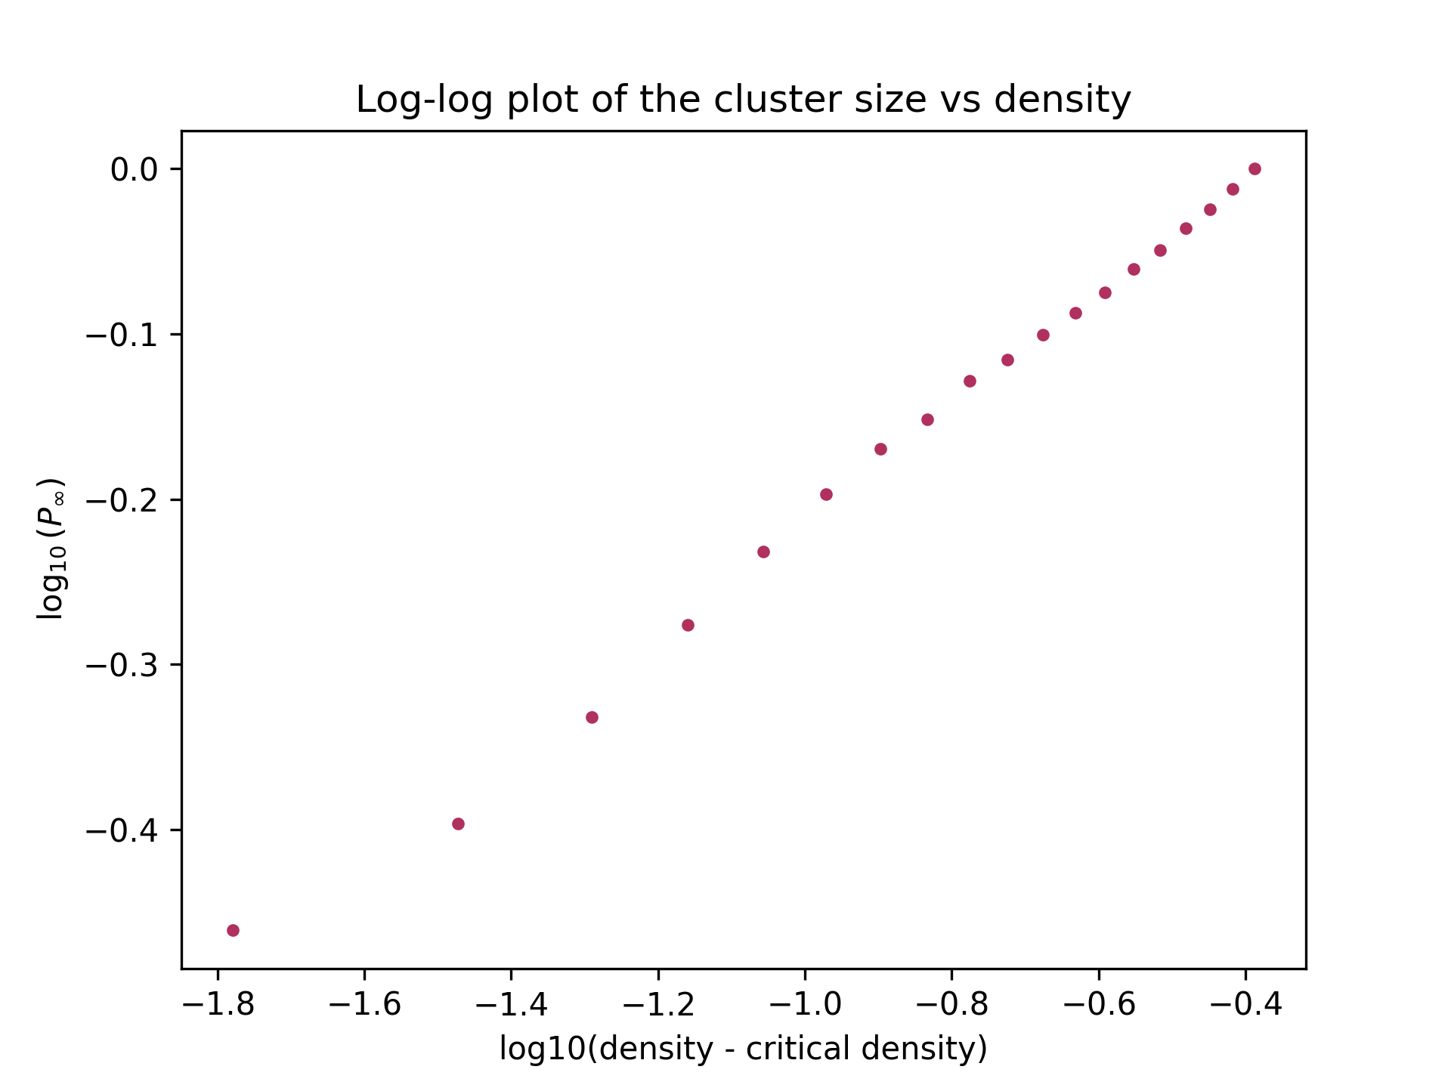
Von Neumann Neighbourhood
Initial Spreader in the Center
Notes:
P_inf = probability that a random site is in the percolation cluster
– order parameter
p_c – critical point
Control parameter the the probability density, more precisely how close it is to the critical probability
We can calculate the size of the biggest cluster and divide it by the total size of the grid to get the probability for a given simulation

Slide 22
Conclusion

Slide 23
Conclusion
How does the rumour percolation probability change as the density of student changes?
How does the rumour percolation probability change as the bond probability of student changes?
For density > 0.59
percolation happens for at least 50% of the simulations
For bond probability > 0.5 percolation occurs for at least 50% of the simulations

Slide 24
Conclusion
How do the critical points vary when the neighbourhood structure is altered?
How does the location of the initial rumour source affect its propagation?
For the Moore neighbourhood all the critical points are shifted to the left
The location of the initial spreader does not affect the critical points

Slide 25
Conclusion
How do the critical points change if we consider both site and bond percolation?
When density decreases, the critical point of bond probability increases and vice versa

Slide 26
Future Work
Use networks instead of CAs to examine large-scale rumour propagation
Include also a role of a person who tries to disprove the rumour

Slide 27
Q&A

Slide 28
Q&A
Notes:
Because there are some gossipers in our class, we wanted to examine how a gossip could spread in a lecture hall for different density and bond probabilities and end up in percolation (gossip had spread in the whole lecture hall)

Slide 29
References

Slide 30
References
Gu, Y., Ding, J. (2013). Research on Rumors Spread Based on Cellular Automata. In: Yang, Y., Ma, M. (eds) Proceedings of the 2nd International Conference on Green Communications and Networks 2012 (GCN 2012): Volume 1. Lecture Notes in Electrical Engineering, vol 223. Springer, Berlin, Heidelberg.
Maitanmi, Stephen & Agbaje, Michael & Adekunle, Yinka. (2013). Model-Based Cellular Automata on Spread of Rumours. 3. 504-510.

Slide 31
Appendix

Slide 32
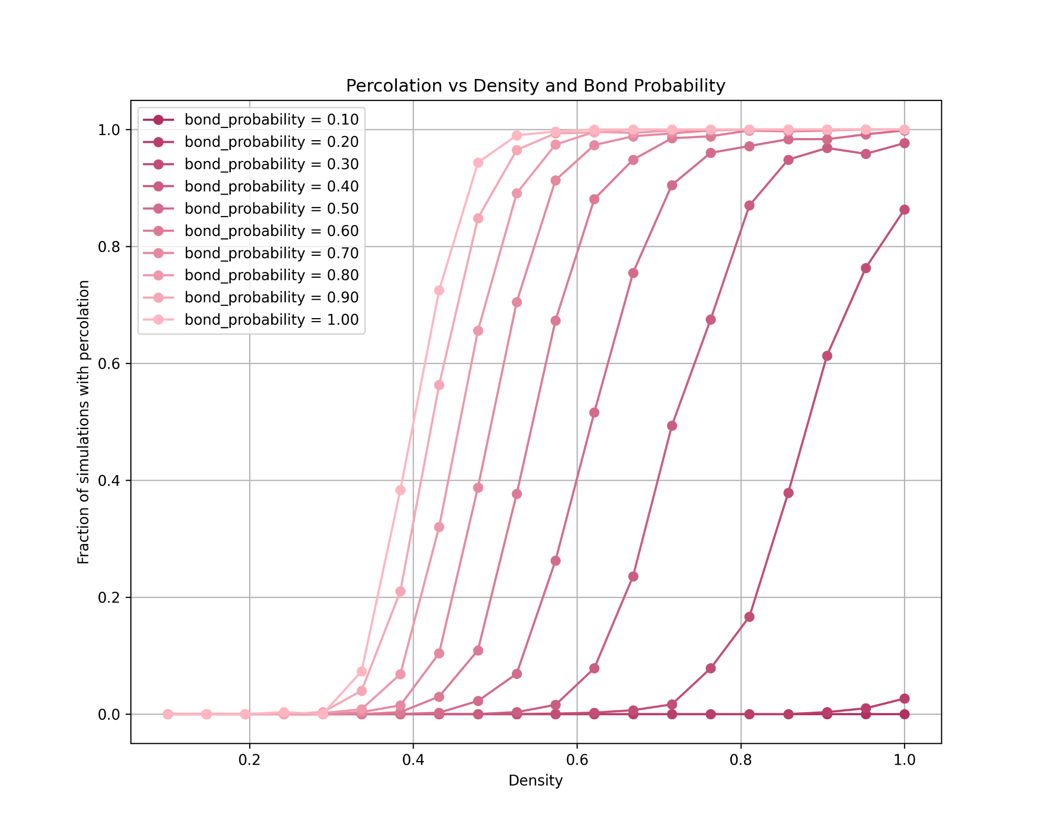
Moore Neighbourhood
Initial Spreader in the Center
Notes:
plot is still running

Slide 33
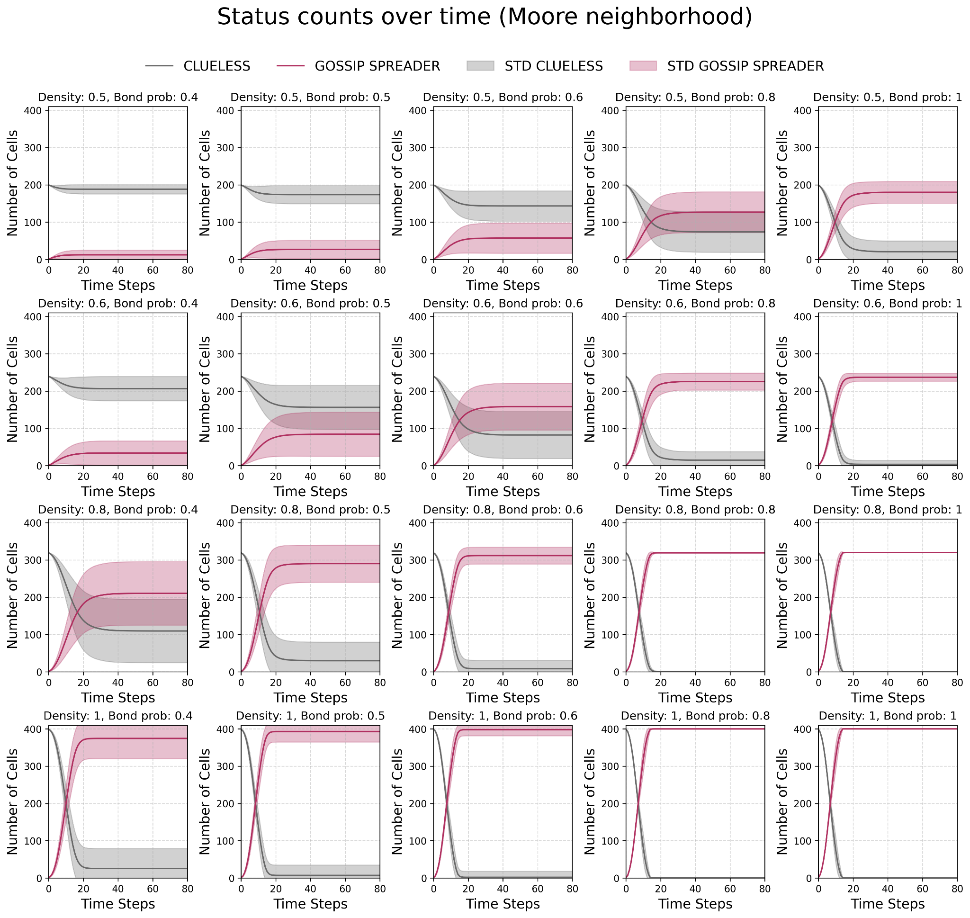

Slide 34
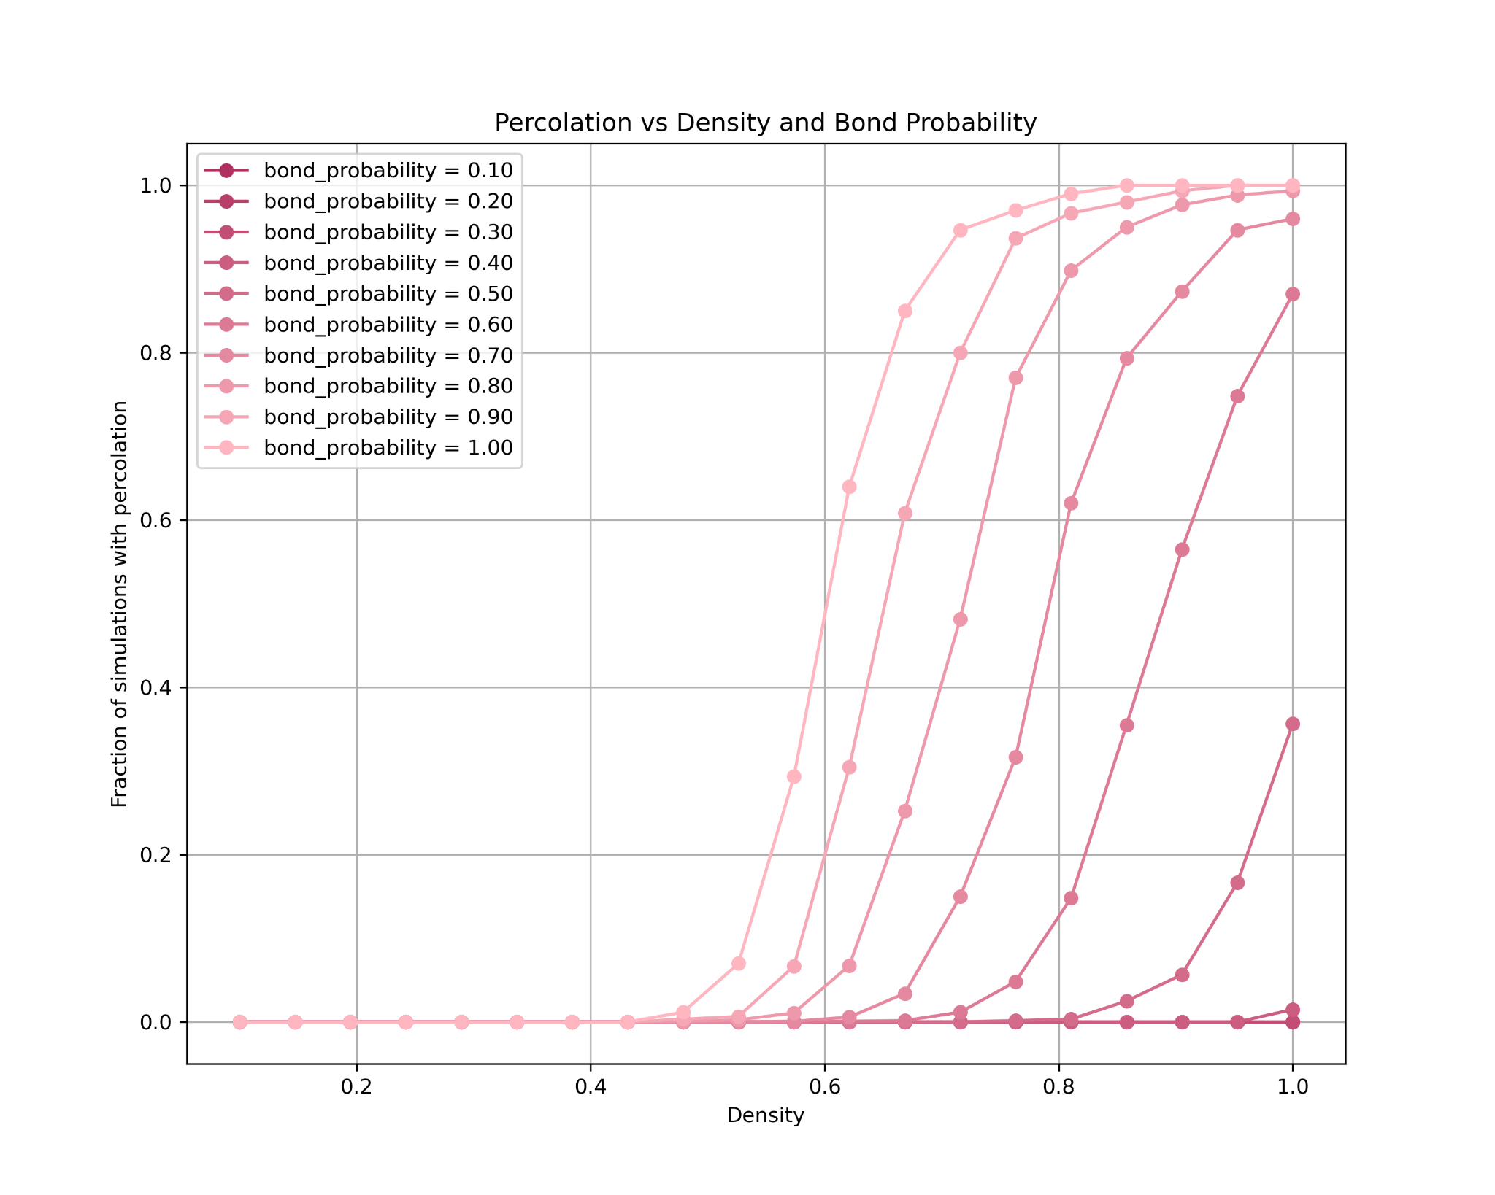
Von Neumann Neighbourhood
Initial Spreader in the Center
Initial Spreader in the Edge
Notes:
Question:
Hypotheses:
mention that:
critical point and the curve moves rightwards slightly = the condition for percolation becomes more strict
distance varies between center & edge - making the percolating slower/harder
but the difference is tiny for the grid is small and uniformly distributed lattice

